Slide 1
2021 Summer Training-
DFT Concept & TetraMAX
Advisor: Prof. Yu-Cheng Fan
Presenter: You-Sheng, Xiao
2021.11.15

Slide 2
Outline
DFT Concept
Tetramax
Practice

Slide 3
DFT Concept
Design For Testability
What is testing?
Testing is a process of determining whether a device is good or not.
Testing includes test pattern generation, application and output evaluation.
Why testing?
In order to guarantee the product quality, reliability, performances, etc.
Cost is the most important.

Slide 4
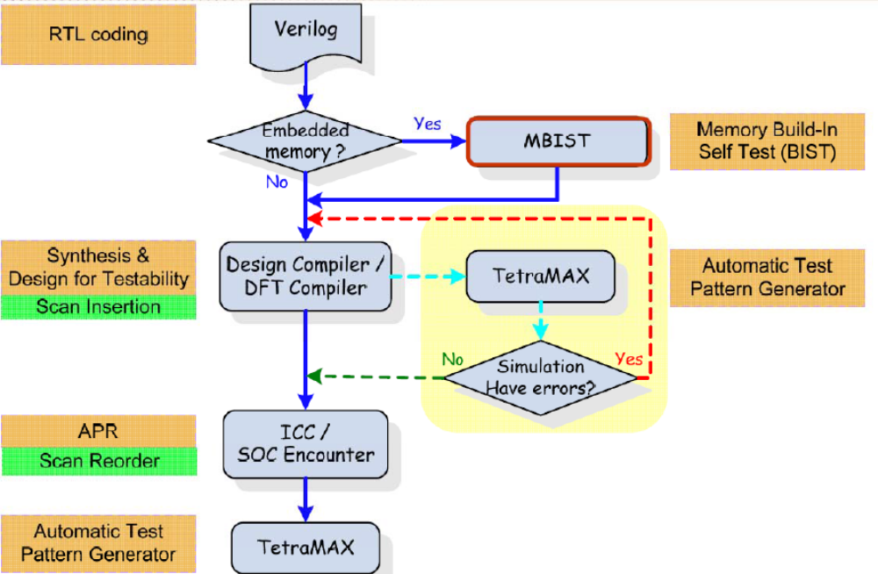
Test Circuit Design Flow

Slide 5
Test Circuit Design Flow

Slide 6
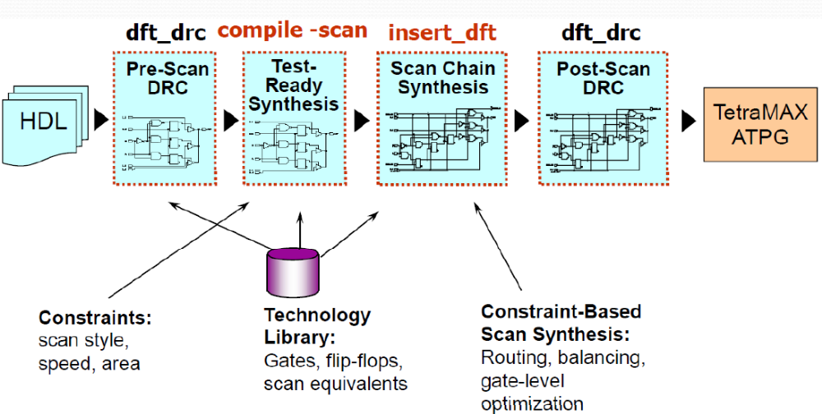
Overview of DFT Compiler Flow

Slide 7
Automatic Test Pattern Generator(ATPG)
Generate the test patterns for target fault model and keep the number of test pattern as small as possible
We will use Synopsys Tetramax EDA tool to automatically generate test pattern
Besides, “fault coverage” of the testing circuits can also be estimated

Slide 8
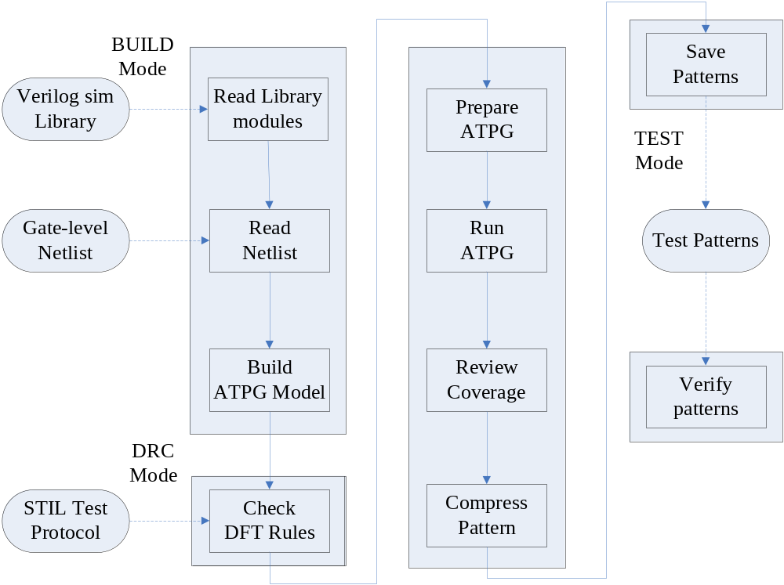
ATPG Flow in TetraMAX

Slide 9
TetraMAX ATPG Command Modes
BUILD mode:
  Initial mode
  Read in design, libraries, models
  Construct ATPG simulation model in preparation for DRCs
DRC mode:
  Testability Design Rule Checks (DRCs) are performed
  Successful conclusion of DRCs sets mode to “TEST”
TEST mode:
  ATPG, fault Simulation, Fault Diagnosis are performed
  Test program files, simulation testbenches, etc. written out

Slide 10
Lab practice
Objective
  Understand the baseline DFT Compiler flow.
  Learn how to use TetraMAX after we generated the STIL procedure file and synthesized netlist from DFT Compiler.

Slide 11
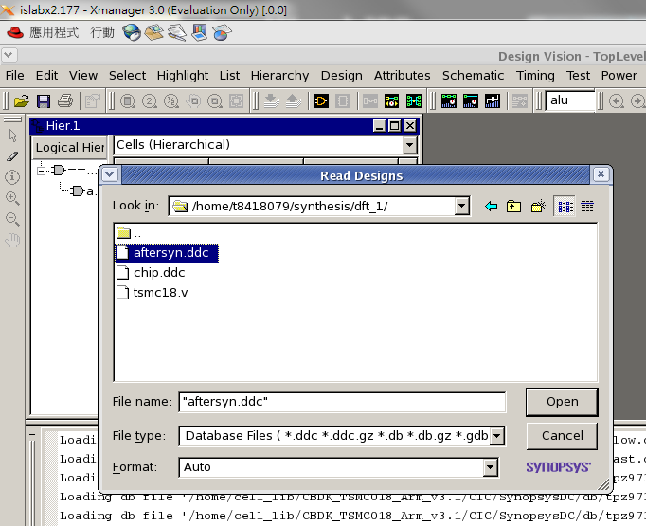
Practice
copy dft folder from /home/standard/summer2021/dft .
Paste to your folder
Open Design vision
Read aftersyn.ddc file
1.
2.
3.

Slide 12

Scripts for DFT
Create test protocol and Perform pre-DFT DRC
  create_port -dir in SCAN_IN
  create_port -dir out SCAN_OUT
  create_port -dir in SCAN_EN
  set_dft_signal -view exist -type ScanClock -timing {45 55} -port clk
  set_dft_signal -view exist -type Reset -active_state 1 -port reset
  create_test_protocol
  dft_drc

Slide 13
Scripts for DFT(cont.)
Perform Test-Ready Compile
  compile -scan -map_effort high -area_effort high -boundary_optimization

Slide 14
Scripts for DFT(cont.)
Specify test components
  set_scan_configuration -chain_count 1 -clock_mixing mix_clocks_not_edges -internal_clocks single -add_lockup false
  set_dft_signal -view spec -port SCAN_IN -type ScanDataIn
  set_dft_signal -view spec -port SCAN_OUT -type ScanDataOut
  set_dft_signal -view spec -port SCAN_EN -type ScanEnable
  -active_state 1
  set_scan_path chain1 -scan_data_in SCAN_IN -scan_data_out SCAN_OUT

Slide 15
Scripts for DFT(cont.)
Preview the scan synthesis, if it is ok, then insert scan.
  preview_dft -show all
  insert_dft

Slide 16
Scripts for DFT(cont.)
Check scan rules after scan inserting and report the result.
  dft_drc -coverage_estimate
  What was the test coverage reported? __98__%
How many scan chains dis you get? ___76_
  report_scan_path -view existing_dft -chain all
How many flip-flops are in each chain? __75___
  report_scan_path -view existing_dft -cell all

Slide 17
Scripts for DFT(cont.)
Save synthesized netlist & STIL procedure file
  write -format verilog -hier -out chip_scan.vg
  write_test_protocol -out chip_scan.spf
  Now you can close Design Vision

Slide 18
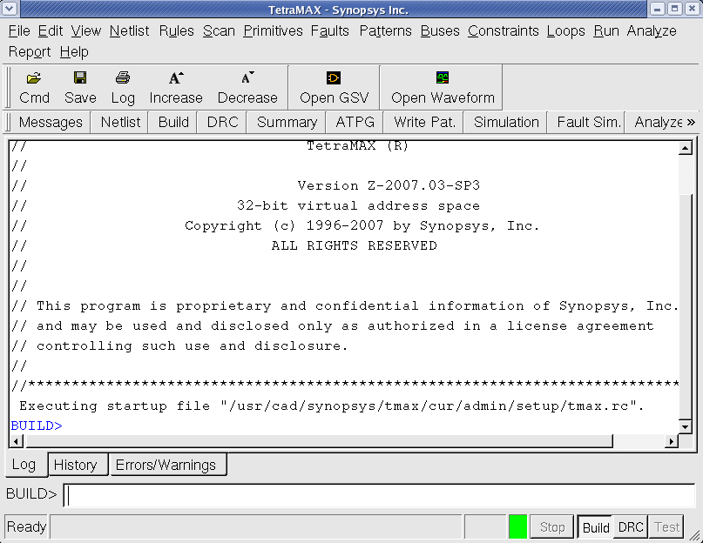
How to open Tetramax
In terminal, please key in “tmax &”, and then Tetramax GUI will display.
Fill the scripts in “BUILD>” column

Slide 19
Scripts for Tetramax
Set messages
  set_messages -log chip.log -replace
Read in library and netlist file
  read_netlist tsmc18.v
  read_netlist chip_scan.vg

Slide 20
Scripts for Tetramax(cont.)
Build the fault simulation model
  run_build_model STI_DAC
Run design rule checking using STIL procedure file
  set_rules C4 ignore
  run_drc chip_scan.spf
Add fault list
  add_faults -all

Slide 21
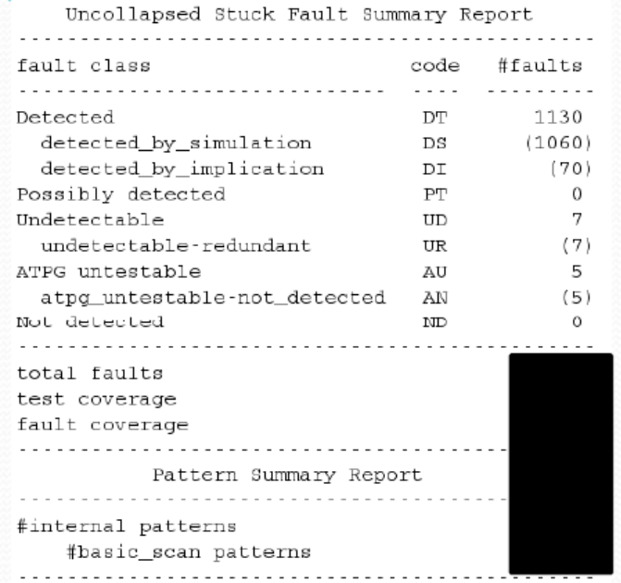
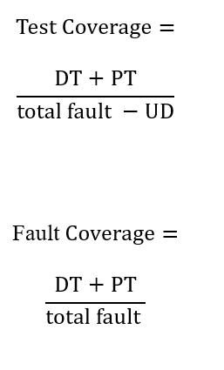
Scripts for Tetramax(cont.)
Run ATPG
  set_pat -internal
  run_atpg -auto
  set_faults -fault_coverage
  set_faults -summary verbose
  report_summaries
How many patterns needed? __125____
What is the total fault count? _3658_____
What is the test coverage? ___98.06__%
What is the fault coverage? __95.22___%

Slide 22
HW
1.作業請寄到islab4072@gmail.com，信件與檔名請統一使用
電子碩X_學號_姓名_DFT，Ex:電子碩二_109368000_王小明_DFT
2.報告請包涵以下內容：
What was the test coverage reported? ______
How many scan chains dis you get? ______
How many flip-flops are in each chain? ______
How many patterns needed? ______
What is the total fault count? ______
What is the fault coverage? ______

Slide 23
Thanks for your attention !

